Slide 1

PREDICTING THYROID MALIGNANCY USING MACHINE LEARNING
Team members : Bhavitha Asam, Sakshi Mehta, Poojitha Surgi, Abla Eklou
Course: SP25: INTRO TO INFORMATICS: 27856
May6, 2025
Indiana University

Slide 2
Introduction
Thyroid cancer is the most common endocrine malignancy, accounting for around 2.5% of all new cancer cases in the United States (Xi et al., 2022).
The incidence of thyroid cancer has increased by 5.5% annually from 2005 to 2015, as indicated by the Surveillance, Epidemiology, and End Results Program (SEER) of the National Institutes of Health (NIH) (Xi et al., 2022).
The goal is to assist clinicians by developing a predictive system that can flag high-risk nodules early, potentially reducing patient anxiety, healthcare costs, and the burden of excessive biopsies.

Slide 3
Aim
To identify significant features contributing to the prediction of thyroid malignancy using both clinical and ultrasound data.
Purpose
To evaluate and compare the performance of machine learning algorithms Random Forest (RF), XGBoost, Multilayer Perceptron (MLP), and an Ensemble model in predicting thyroid cancer.

Slide 4
Problem Statement & Significance
Problem:
Differentiating between benign and malignant thyroid nodules remains challenging using standard clinical evaluation and ultrasound.
Traditional methods (e.g., TI-RADS) rely on radiologist interpretation and may result in unnecessary biopsies or missed malignancies.
Significance:
Thyroid cancer is the fastest-growing endocrine malignancy worldwide.
Accurate, data-driven risk prediction can reduce overdiagnosis, improve early detection, and assist in clinical decision-making.
Our approach uses machine learning + clinical + ultrasound features to build a reproducible and objective prediction system.

Slide 5
Research Hypothesis
Null Hypothesis (H₀): The characteristics derived from clinical and ultrasound data are not effective in predicting whether a thyroid nodule is benign or malignant.
Alternative Hypothesis (H₁): The characteristics derived from clinical and ultrasound data are effective in predicting whether a thyroid nodule is benign or malignant.

Slide 6
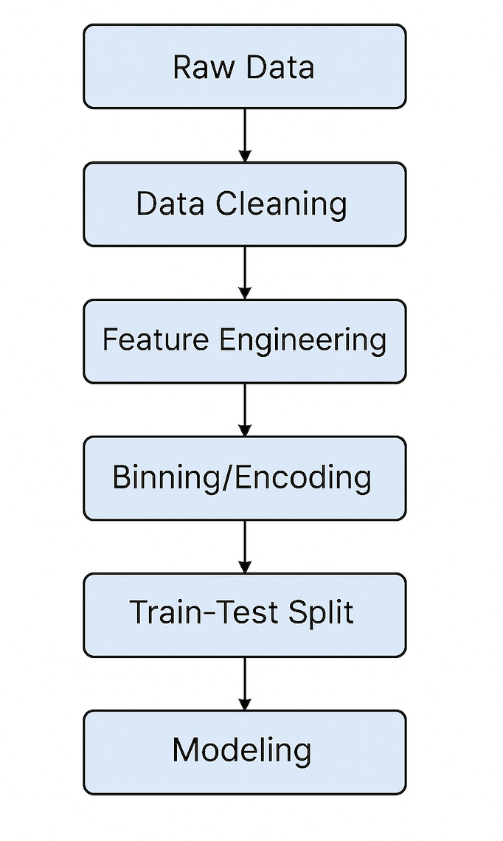
Project Plan

Slide 7
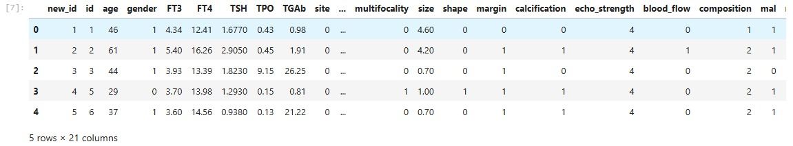
Data Set Raw Dataset Summary
Source: Zenodo Open Repository https://zenodo.org/records/6465436
Collected from patients who were admitted to Shengjing Hospital of China Median University
Total Records: 1,232 rows, 724 patients
Total Features: 21 columns
Target Variable: mal (1 = Malignant, 0 = Benign)
Features include:
Demographics: age, gender
Lab Tests: FT3, FT4, TSH, TPO, TGAb
Ultrasound Attributes: site, echo pattern, multifocality, shape, margin, calcification, echo strength, blood flow, composition, size, multilateral

Slide 8
Preprocessing and feature engineering
Data Cleaning: Converted byte columns from SQL to integers One row per patient retained using malignancy-priority
Categorization: Hormones (Chen et al., 2018): TSH, FT3, FT4, TPO, TGAb → Low / Normal / High Tumor Size (Haugen et al., 2016): ≤1 cm, 1–2 cm, 2–4 cm, >4 cm Patient Age (Cheng et al., 2024): <55 y / ≥55 y

Slide 9
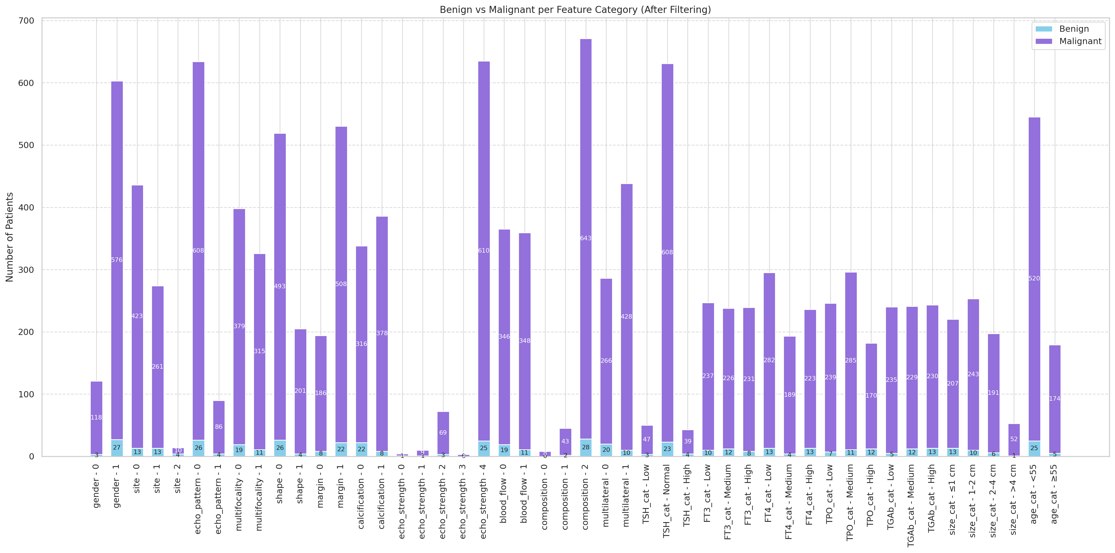
Exploratory Data Analysis

Slide 10
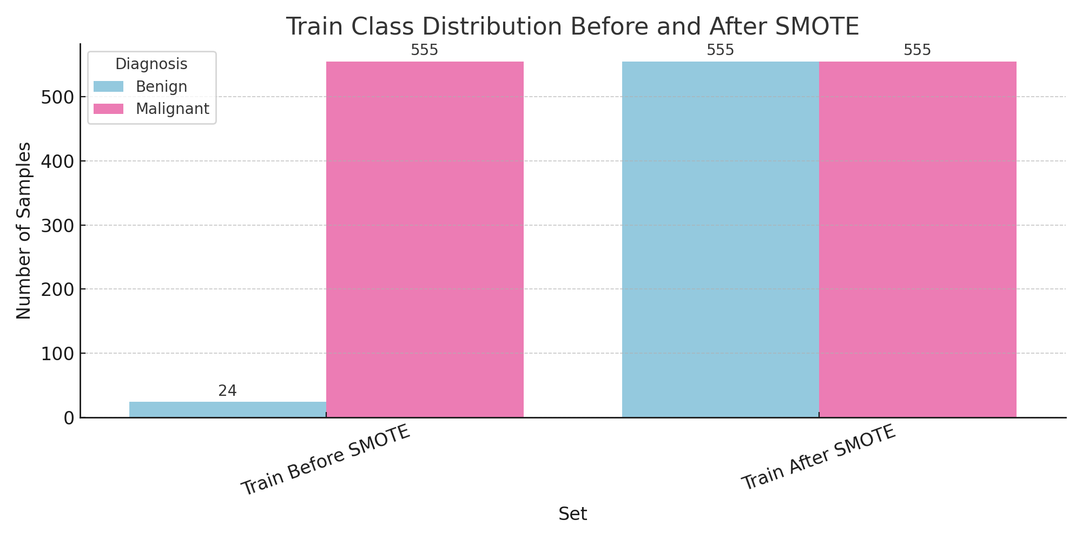
Train-Test Split & Class Distribution
Final dataset: 724 patients (1 row per patient, malignancy-priority filtering)
Features: All variables converted to categorical format
Train-test split: 80 / 20 (Stratified)
Train set: 579 rows
Test set: 145 rows
Class Distribution
Before SMOTE
Train: 555 malignant (1), 24 benign (0)
Test: 139 malignant (1), 6 benign (0)
After SMOTE
Train: 555 malignant / 555 benign

Slide 11
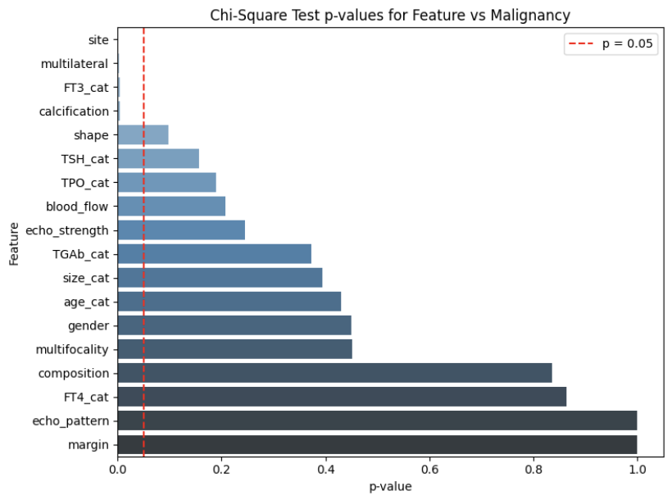
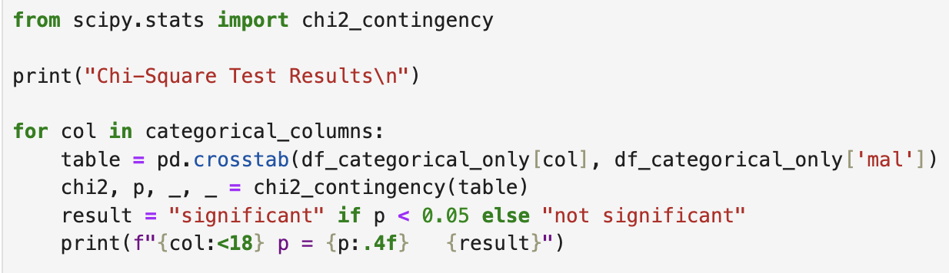
Statistical Tests and Justification
Test Used: Chi-Square Test
Why Chi-Square?
Standard test for associations between categorical variables
All 18 features were categorized
Helps identify variables strongly linked to malignancy
Significance Threshold:
p-value < 0.05 → Statistically significant association
Top Significant Features:
Site, Multilateral, FT3, Calcification

Slide 12
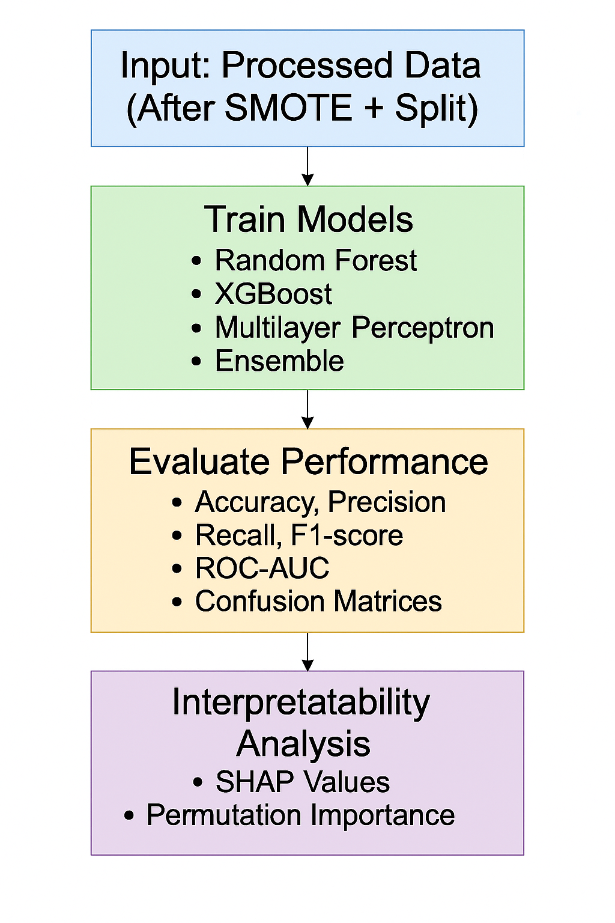
Model Training & Evaluation Workflow

Slide 13
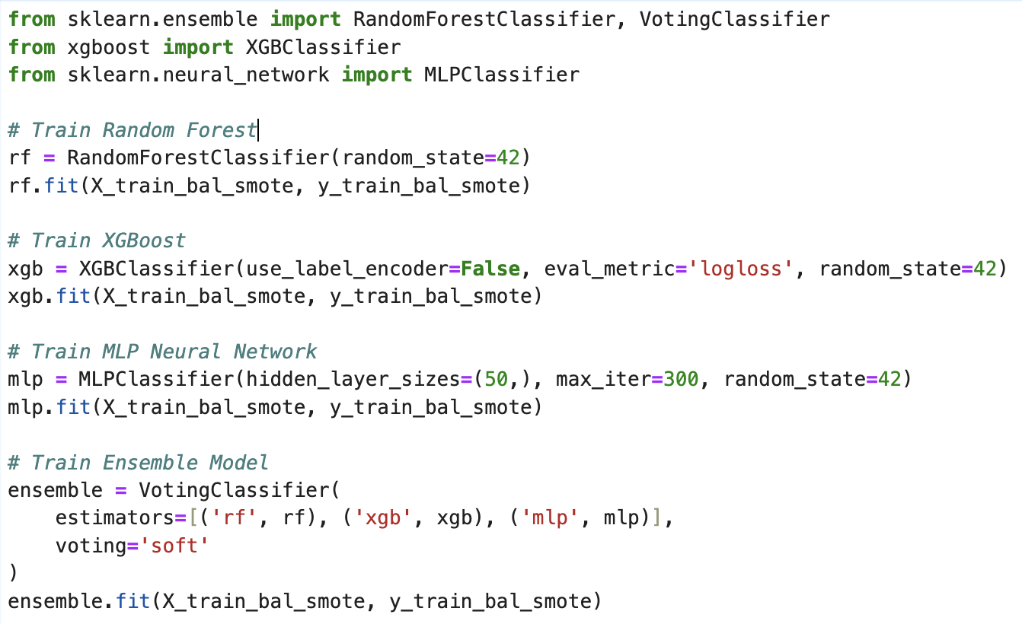
Model Performance
Models used: Random Forest, XGBoost, MLP, Ensemble
Training set: Balanced using SMOTE
Metrics: Accuracy, Precision, Recall, F1-Score, ROC AUC
Observation: All models achieved high recall, rarely missing malignant cases

Slide 14
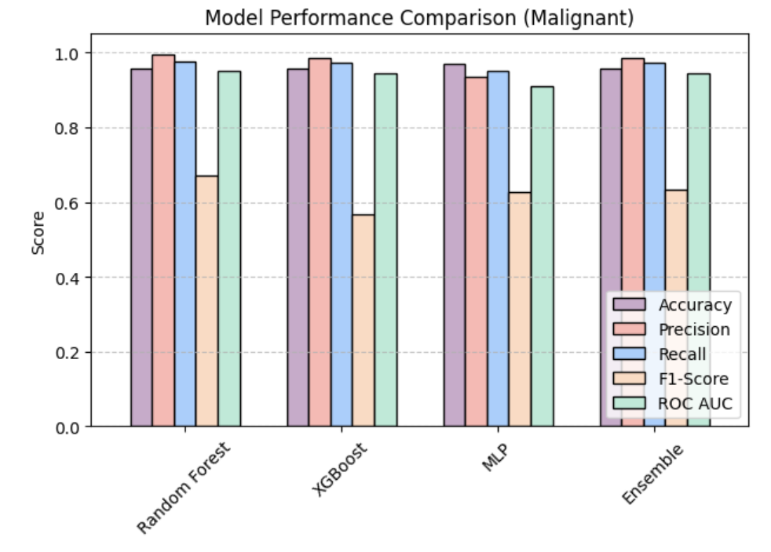
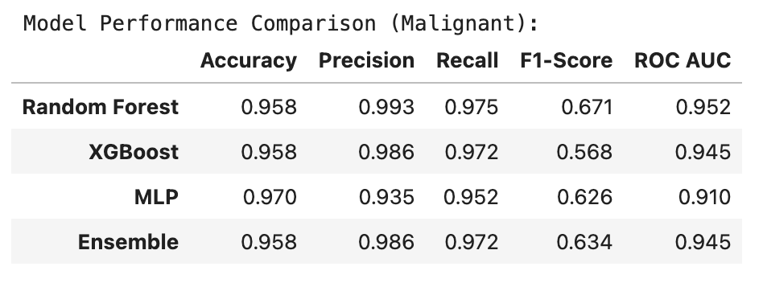
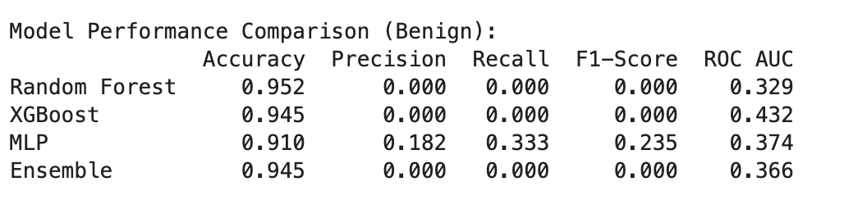
Model Evaluation Results

Slide 15
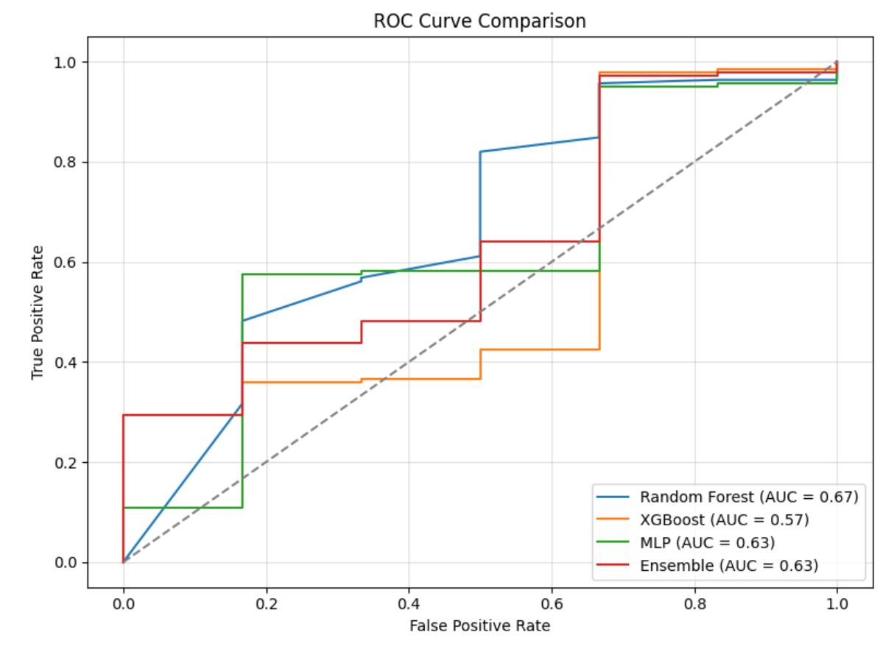
ROC Curve Comparison
Random Forest showed the highest AUC , best at distinguishing classes
XGBoost had the lowest AUC , least effective
MLP and Ensemble showed moderate AUC, performed similarly
ROC curves highlight each model’s discrimination ability

Slide 16
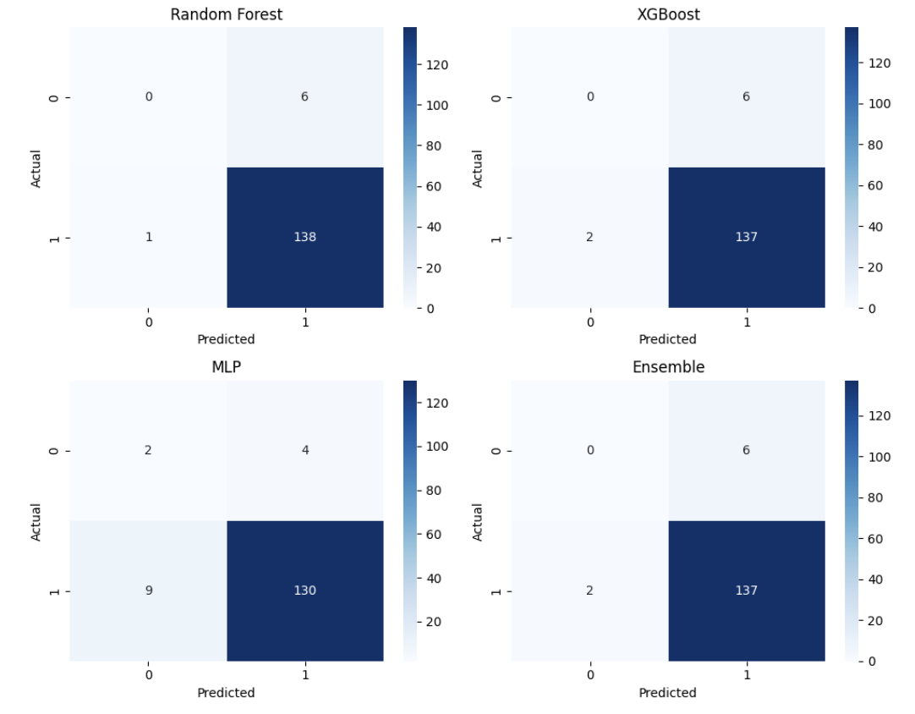
Confusion Matrix Analysis: Model Predictions on Test Set
Most models correctly predicted malignant (1) cases
Random Forest misclassified only 1 malignant, none benign
XGBoost and Ensemble misclassified 2 malignant cases
MLP had the highest error: 9 malignant and 2 benign misclassified
Highlights strong sensitivity (recall) but weaker benign detection

Slide 17
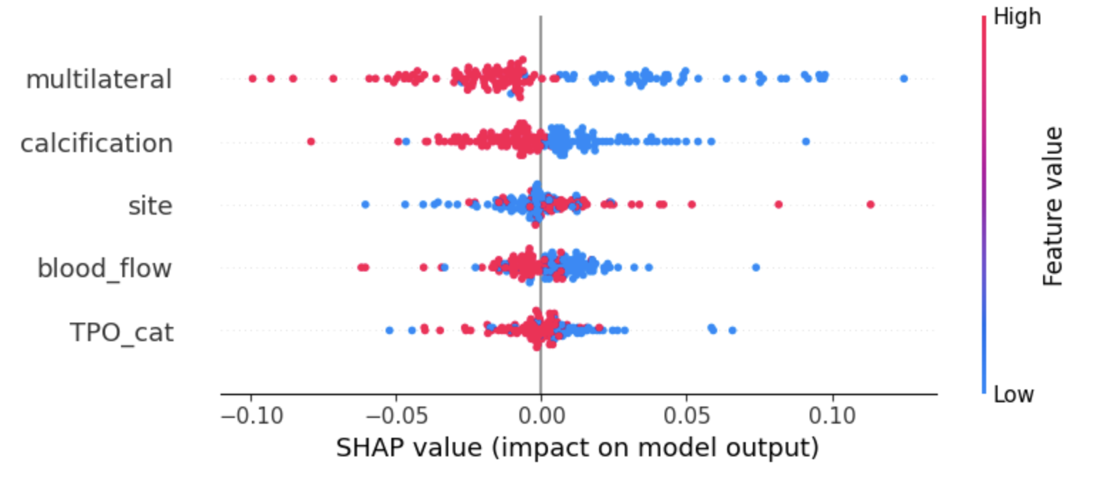
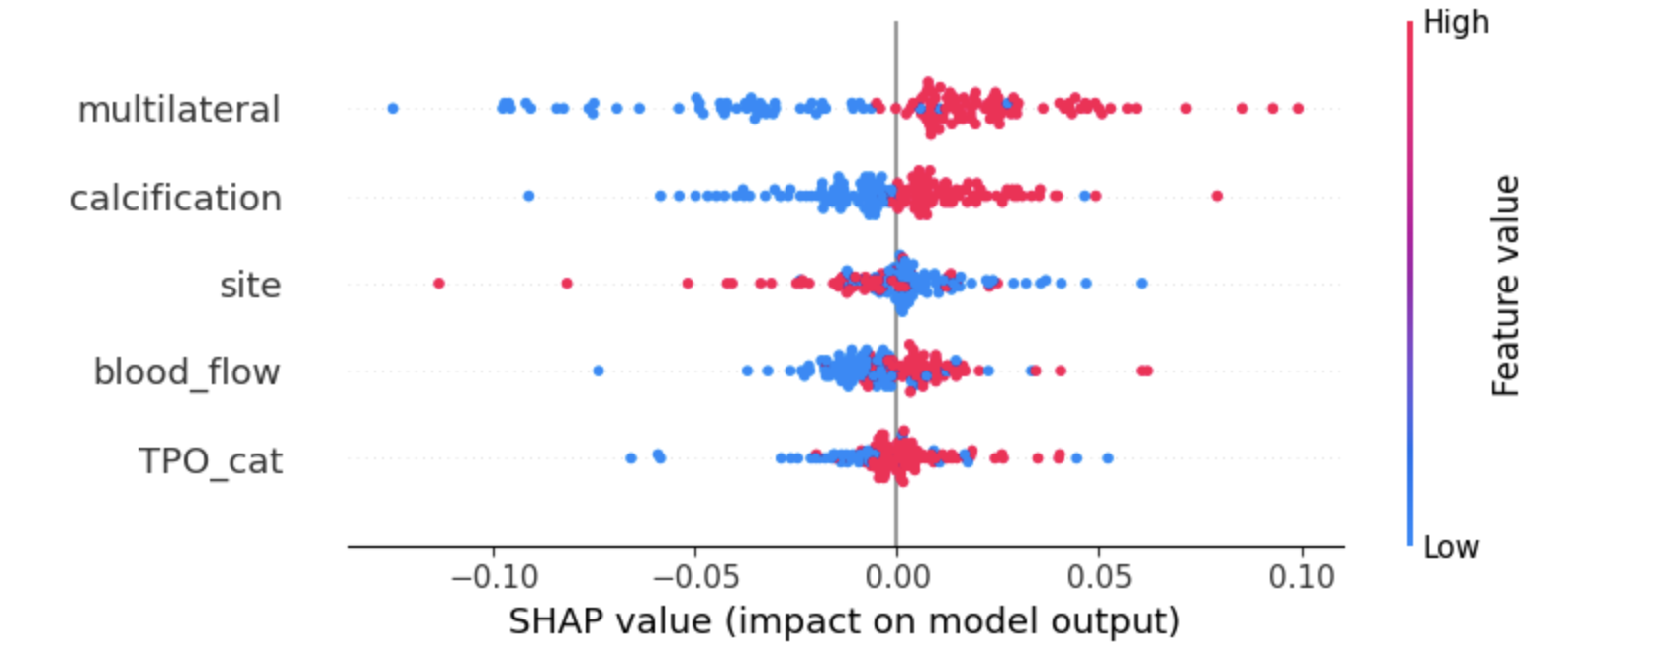
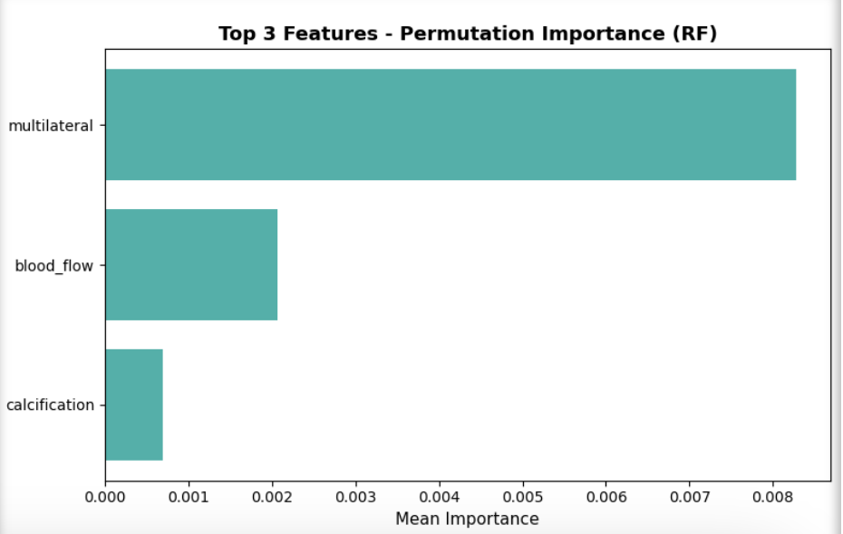
Feature Importance: SHAP & Permutation Analysis
SHAP Summary (Random Forest)
Malignant Class (Class 1):
Most impactful: Multilateral, Calcification, Site, Blood Flow, TPO
Benign Class (Class 0):
Same top 5 features, but impact direction differs
Permutation Importance (Random Forest)
Top predictive features:
Multilateral
Blood Flow
Calcification

Slide 18
Insights and interpretability
Quantitative Results
Random Forest achieved highest F1 Score (0.98) and ROC AUC (0.67)
MLP achieved highest precision (0.97) – least false positives
Ensemble Model gave moderate performance (F1 = 0.95, AUC = 0.63)
All models had high recall (sensitivity) – rarely missed malignant cases
XGBoost had the lowest AUC (0.57) and recall – struggled with class imbalance
Qualitative Results
Top features identified commonly by both SHAP and permutation importance: Multilateral, Calcification, Site, Blood flow
These features match clinical expectations, enhancing trust in model predictions
Models showed low specificity – benign cases harder to classify due to data imbalance
Ensemble model did not outperform Random Forest
Results can help support early detection, reducing unnecessary biopsies

Slide 19
Fit to Literature
Our study aligns with Hosseini Sarkhosh et al. (2025) in using ML for thyroid malignancy prediction
Both studies confirm that tree-based models outperform traditional clinical guidelines
Their study validated XGBoost as the best performer, while our project demonstrated Random Forest as more effective
Clinical and ultrasound features were key predictors in both approaches
SHAP analysis enhanced model interpretability, complementing their logistic regression-based feature selection
Both studies support the potential of ML to improve diagnostic efficiency and reduce unnecessary procedures like FNA

Slide 20
Contribution:
MEMBER | PRIMARY CONTRIBUTIONS
Sakshi | Data Acquisition and Preparation
Bhavitha | Feature Engineering and preprocessing
Abla | EDA and statistical Analysis
Poojitha | Modelling and evaluation

Slide 21
Conclusion
Study Goal Achieved: Successfully predicted thyroid malignancy using clinical and ultrasound data.
Our findings support the alternative hypothesis: Features were effective in distinguishing between benign and malignant nodules.
Random Forest stood out as the most reliable model for this task.
Feature Analysis aligned with clinical understanding, boosting model credibility (e.g., multilateral, calcification).
Low specificity highlights real-world challenge of detecting benign nodules — points to the need for better data balance.
Clinical Impact: Models like ours can reduce unnecessary FNAs and aid early decision-making.

Slide 22
References
Bomeli, S. R., LeBeau, S. O., & Ferris, R. L. (2010). Evaluation of a thyroid nodule. Otolaryngologic Clinics of North America, 43(2), 229–vii. https://doi.org/10.1016/j.otc.2010.01.002
Chen, X., Zhou, Y., Zhou, M., Yin, Q., & Wang, S. (2018). Diagnostic values of free triiodothyronine and free thyroxine and the ratio of free triiodothyronine to free thyroxine in thyrotoxicosis. BioMed Research International, 2018, Article 5842534. https://doi.org/10.1155/2018/5842534
Cheng, J., Han, B., Chen, Y., et al. (2024). Clinical risk factors and cancer risk of thyroid imaging reporting and data system category 4A thyroid nodules. Journal of Cancer Research and Clinical Oncology, 150, 327. https://doi.org/10.1007/s00432-024-05847-7
Haugen, B. R., Alexander, E. K., Bible, K. C., Doherty, G. M., Mandel, S. J., Nikiforov, Y. E., ... & Wartofsky, L. (2016). 2015 American Thyroid Association management guidelines for adult patients with thyroid nodules and differentiated thyroid cancer: The American Thyroid Association Guidelines Task Force on Thyroid Nodules and Differentiated Thyroid Cancer. Thyroid, 26(1), 1–133. https://doi.org/10.1089/thy.2015.0020
Xi, N. M., Wang, L., & Yang, C. (2022). Improving the diagnosis of thyroid cancer by machine learning and clinical data. Scientific Reports, 12(1), 11143. https://doi.org/10.1038/s41598-022-15342-z

Slide 23
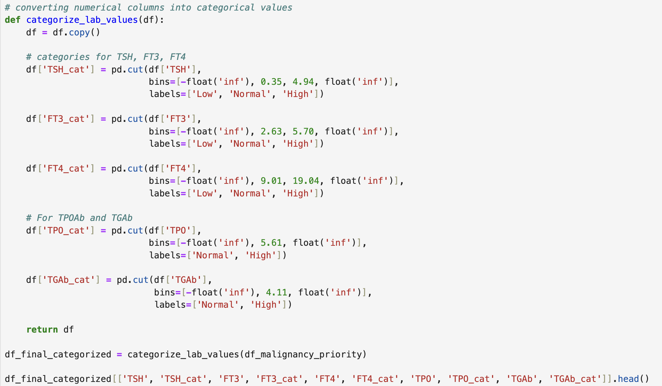
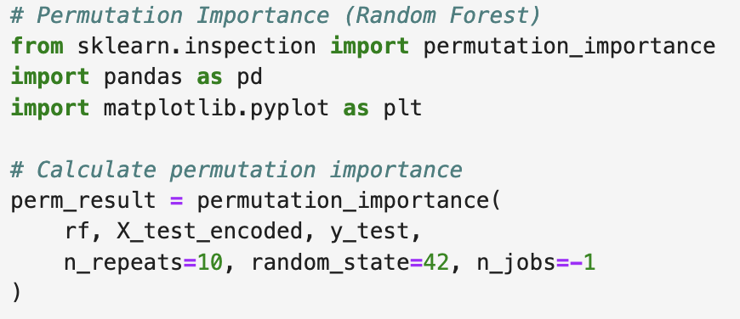
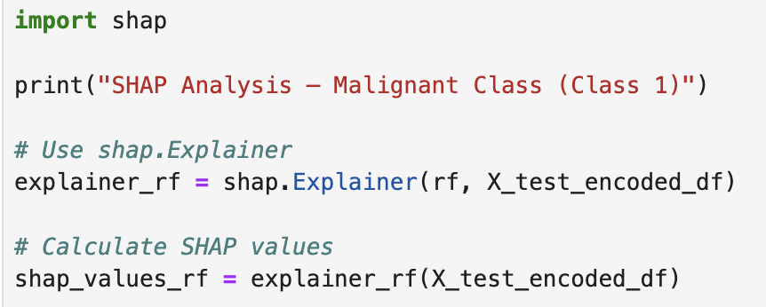
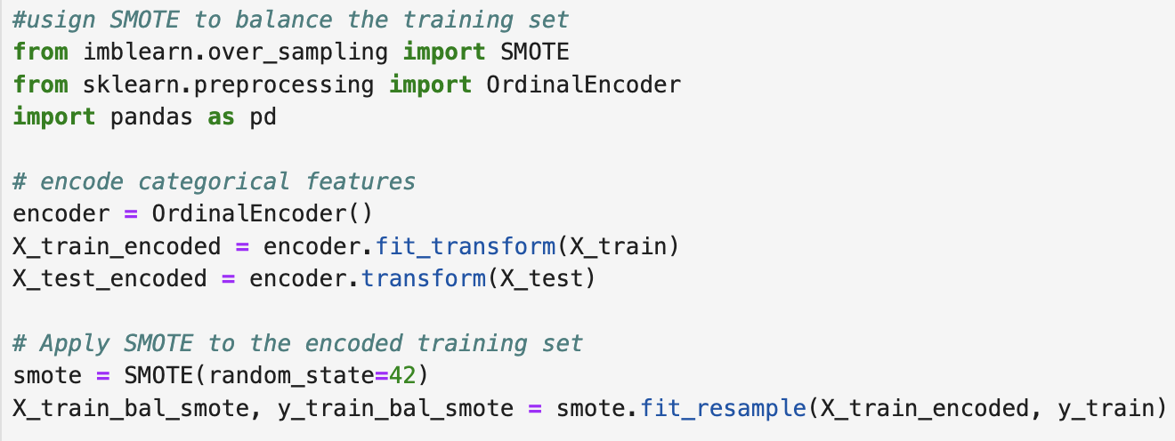
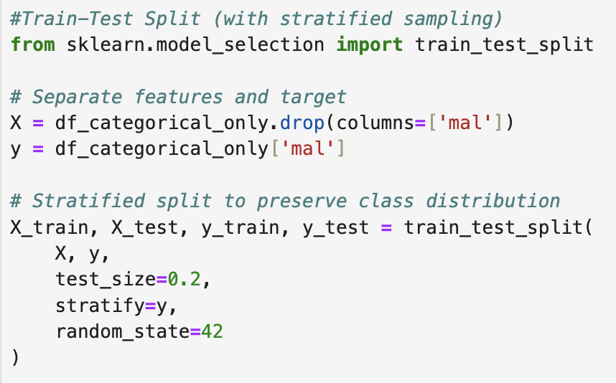
Appendix

Slide 24

Thank You

